Slide 1
Python for Data Science
ETEC workshop
June 7-9, 2021
Welcome!
Here are the materials
http://github.com/worldbank/Python-for-DataScience/tree/master/June_2021_ETEC

Slide 2
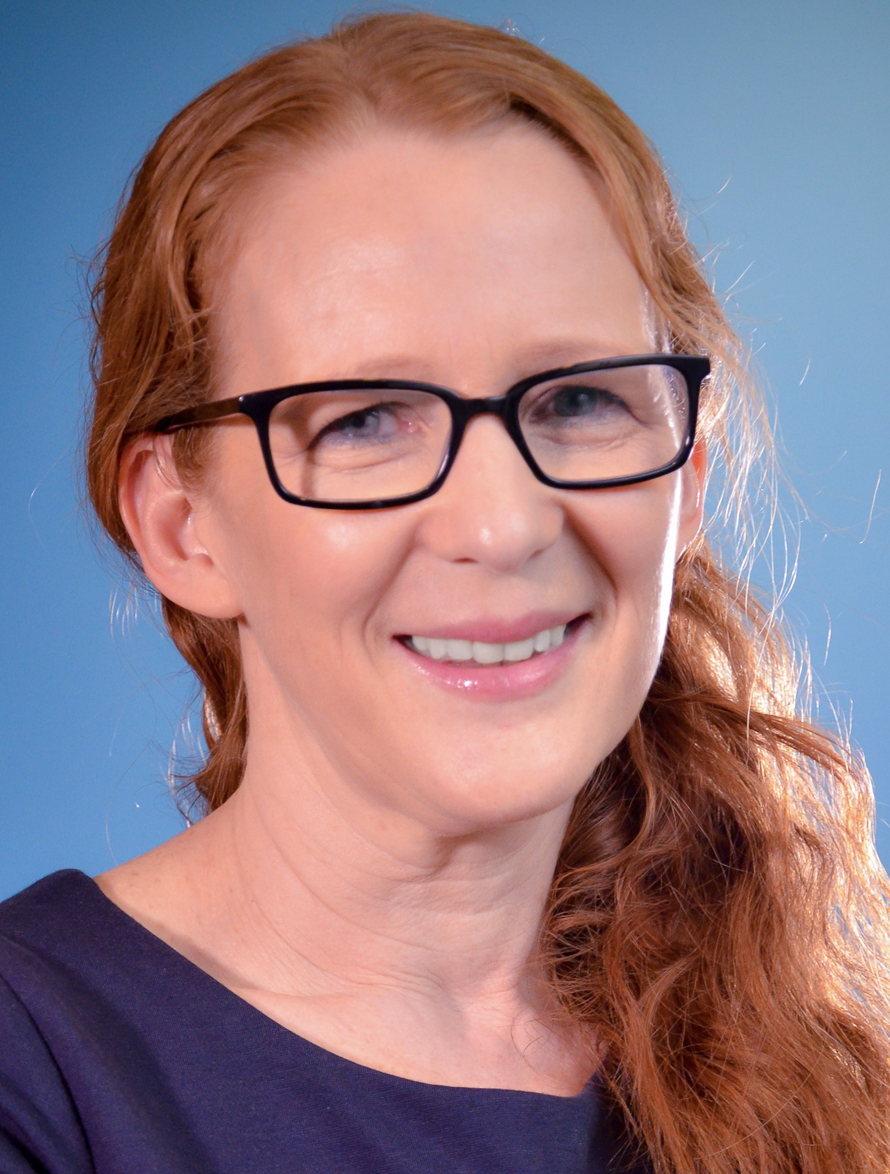

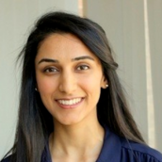



Workshop team
Nick Jones
Data Scientist, World Bank
Dharana Rijal
Data Science Consultant, World Bank
Laura Gregory
Senior Education Specialist, World Bank
Mahmoud Elsayed
Economist, World Bank
Maham Khan
Data Science Consultant, World Bank
Gaurav Bhardwaj
Data Scientist, World Bank

Slide 3
Welcome and context

Slide 4
Participant outcomes
With no prior coding skills assumed, learn to:
access and combine datasets;
use libraries for data analysis and plotting;
self-teach next steps.

Slide 5
Programming shares many concepts from everyday life.

Slide 6
Guess the output (1)
Ingredients
2 cups flour
Half cup butter
Half cup sugar
1 t. Salt
1 egg
1 cup chocolate chips
Method
1. Mix all ingredients
2. Knead thoroughly
3. Form into 20 balls.
4. For each ball:
Spread flour on cloth
Roll ball in circle with rolling pin
Cook in oven

Slide 7
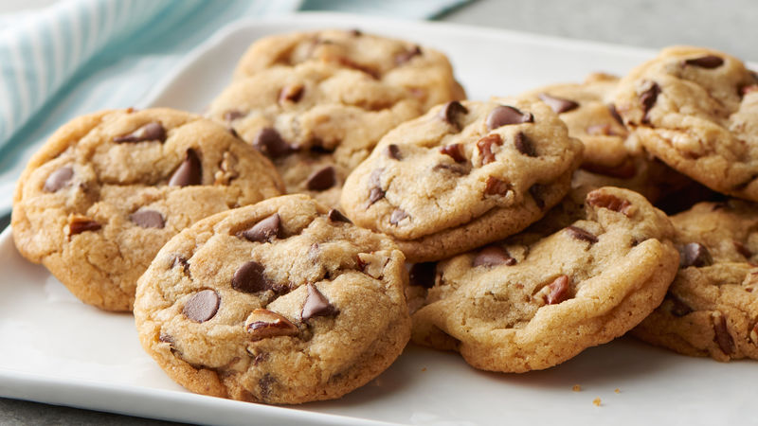
Credit: Think Python! Allen Downey
Chocolate chip cookies (makes 20)

Slide 8
Key elements of programming (and food recipes!)
A set of words, abbreviations and symbols (terminology and syntax).
A sequence of operations to be performed in order.
Repetition of some operations (loops)
Logical tests (conditions)
Credit: Think Python! Allen Downey

Slide 9
Guess the output (1)
Specialized terminology, loops, and logic are common ways of thinking in many domains (including cooking and coding)
Ingredients
2 cups flour
Half cup butter
Half cup sugar
1 t. Salt
1 egg
1 cup chocolate chips
Method
1. Mix all ingredients
2. Knead thoroughly
3. Form into 20 balls.
4. For each ball:
Spread flour on cloth
Roll ball in circle with rolling pin
Cook in oven

Slide 10

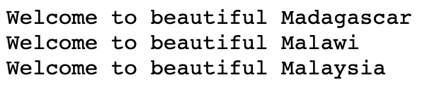
Guess the output (2)
elements of syntax
loop
list

Slide 11
Data science – a combination of skills:

Slide 12
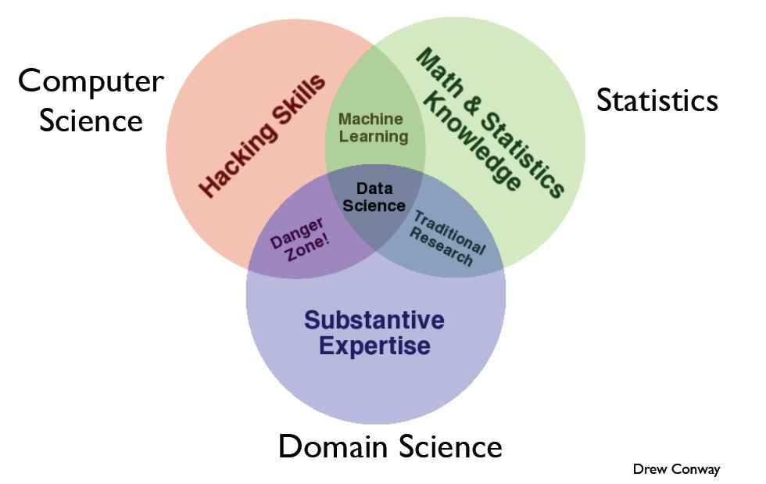
Computer
science
Math & stats
Domain expertise

Slide 13
Why Python for Data Science?

Slide 14
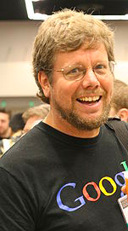
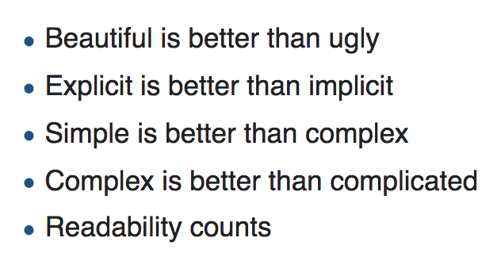
Why Python for data science?
the Zen of Python:
Python’s founder Guido van Rossum

Slide 15
Why Python for data science?
the Zen of Python:
Whitespace instead of symbols
code remains uncluttered
tabs and line-breaks matter
Intuitive grammar
easy to understand
Variable types determined automatically
no need to declare the type of your variables before assigning values
Python’s founder Guido van Rossum

Slide 16
Three advantages:

Slide 17
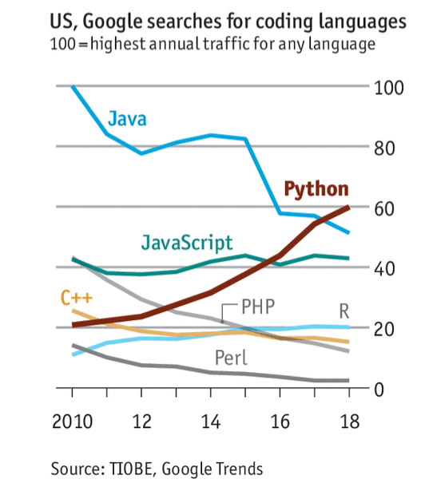
1. Python is popular
Large user community
Well-maintained libraries
Online guidance (StackOverflow)

Slide 18
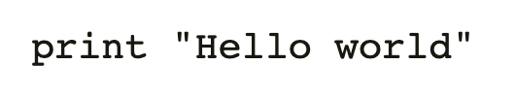
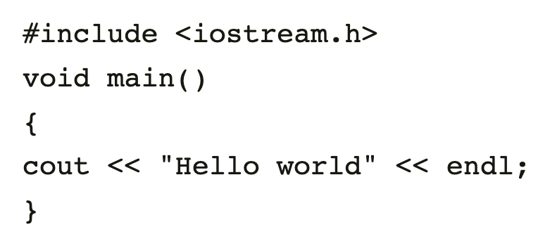
2. Easy to learn and share
WHY PEOPLE LIKE IT:
Code is intuitive and expressive (compare C++)
Suited to large amounts of data

Slide 19
3. Thriving ecosystem of tools
Get data
Clean data
Modeling and analysis
Evaluate and present
Data science work-flow
mySQL client
BeautifulSoup
API clients
Pandas
Geopandas
Rasterio
Numpy
scipy
statsmodel
SciKitLearn
Jupyter Notebook
Matplotlib
Flask
Example libraries

Slide 20
Intro to Python notebooks

Slide 21
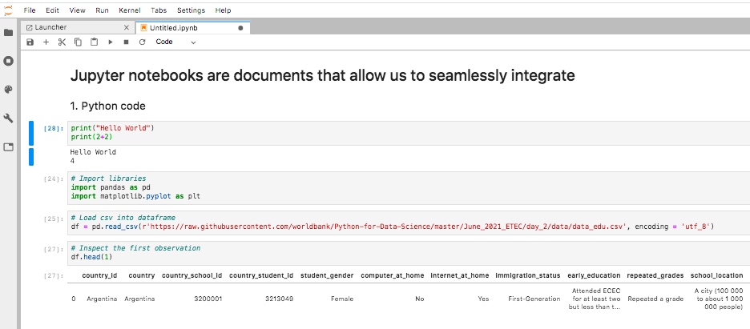

Slide 22
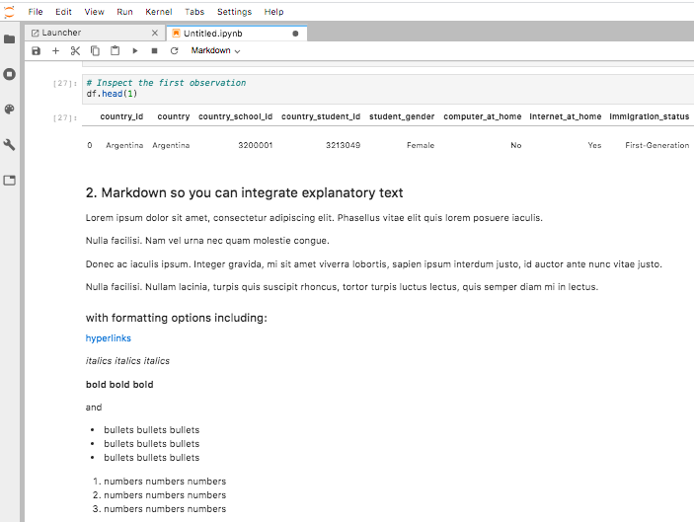

Slide 23
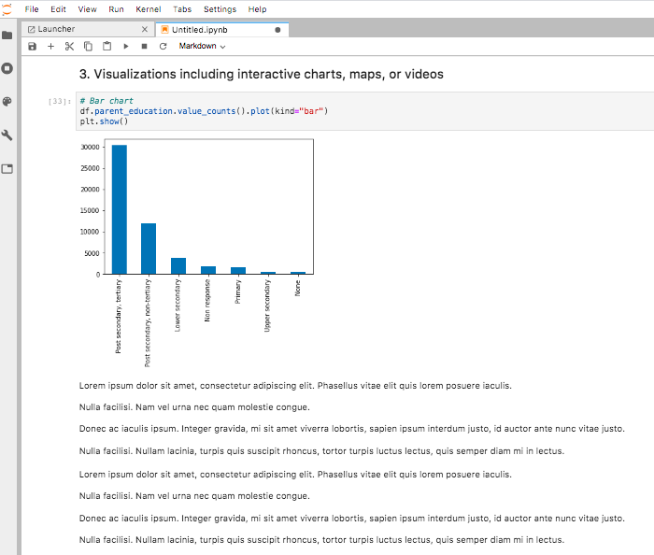

Slide 24
Getting started

Slide 25
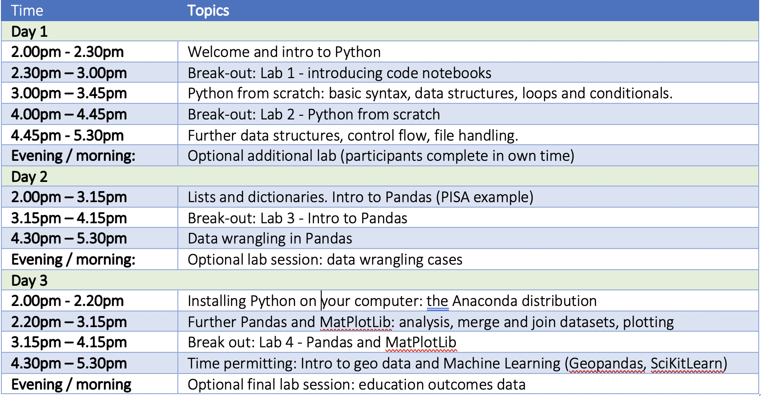
Course outline

Slide 26
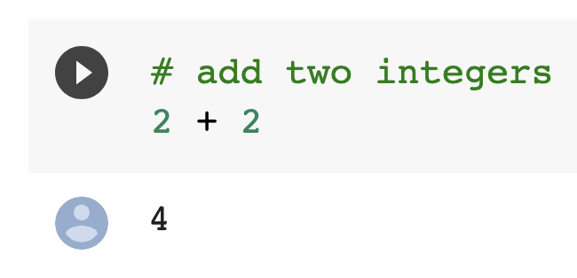
Using Google Colab
Learn the notebook format
Document comprising text, code, and outputs
Run code cells two ways
Click this button →
Or use keyboard shortcuts
Account: Ensure you’re logged on to your Google account
Permissions: When prompted click ‘run anyway’.
Objectives for Lab session 1:
Learn how to create new cells (text and code)
Write and run your own code.

Slide 27
Getting started
bookmark this
Course website: https://github.com/worldbank/Python-for-Data-Science/tree/master/June_2021_ETEC
First exercise
Scroll down on GitHub ‘day_1’ page, click the link for ‘0_notebooks_intro’

Slide 28
Getting started
bookmark this
Course website: https://github.com/worldbank/Python-for-Data-Science/tree/master/June_2021_ETEC
First exercise
Scroll down on GitHub ‘day_1’ page, click the link for ‘0_notebooks_intro’
Starting with Colab
Ensure you’re logged on to your Google account
Click ‘connect’
De-select ‘reset all runtimes’ and click ‘run anyway’

